Slide 1
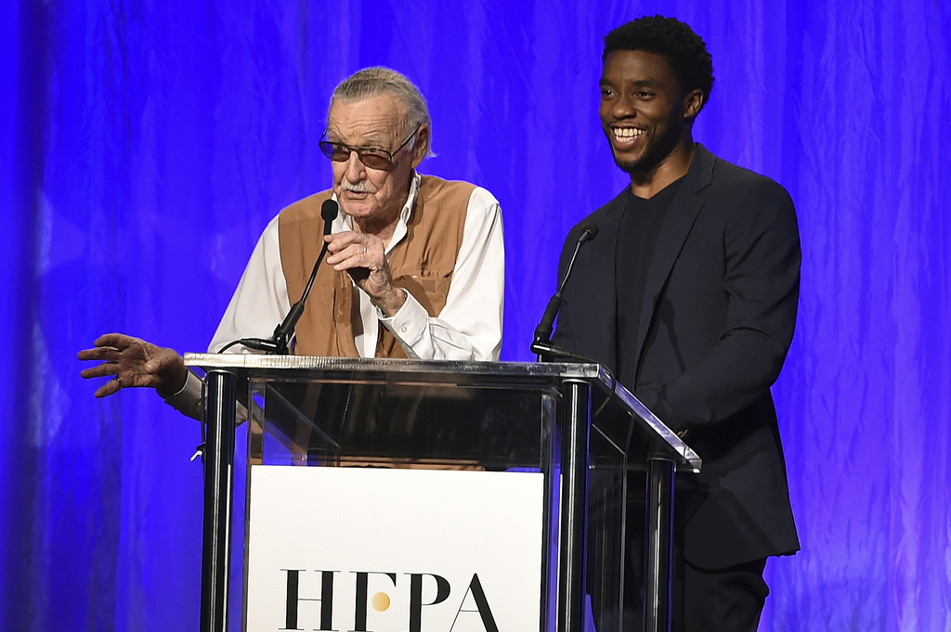
The faces of colorectal cancer are changing….. …………we must adapt our approach! A complementary, not competitive, messaging strategy
Lead time messaging
On-time screening
Whitney F Jones, MD
coloncancerpreventionproject.org
Upstream Health Strategies, LLC
Fight CRC EAO work group
November 3, 2020

Slide 2
% Eligible Actually Screened
Goal
> 80% High Risk
ID + screen (Cscope)
> 90% Normal Risk screened at age 45
100
90
80
Goal
70
60
50
Current
Current
< 1 in 4 high risk screened on time
~ 10% screened at 45
~ 50% screened at 50
40
30
20
80% Persistent Compliance
10
20
30
40
50
60
70
80
AGE

Slide 3
Critical questions for potential study
Is on-time screening time important?
Too hard to measure?
Not critical?
We can’t do family history well?
Opportunities for CRC prevention if 80% achieved on time
disparities, high risk, normal risk
How to screen those not engaged with health system?
Best way to inform around sporadic EAO CRC?
Do we believe in genetics>? Why do we use so little?

Slide 4
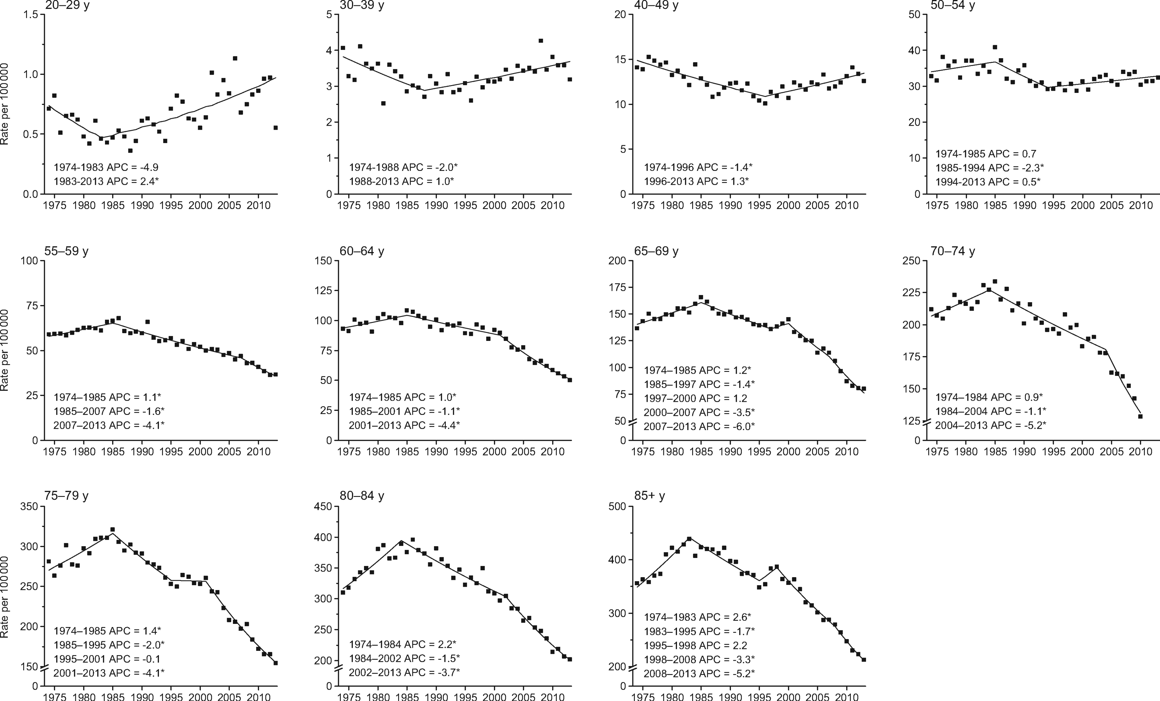
From: Colorectal Cancer Incidence Patterns in the United States, 1974–2013. J Natl Cancer Inst. 2017;109(8). doi:10.1093/jnci/djw322. © The Author 2017. Published by Oxford University Press.

Slide 5
The odds are NOT in your favor (until you are 55) How many must we reach?
High risk
@ age 40?
?? 45-49
Avg risk

Slide 6
What we don’t have to do
Develop new guidelines
Redefine elevated risk groups
Deal with 50 vs 45 vs states
Study if guidelines work
Invent Cancer Family History
Figure out if marketing works
Develop new testing options

Slide 7
Under age 50 CRC: Timeline considerations
Optimistic we find out why within 10 yrs.
so we can, if able, counteract the cause
Millions of people are at risk now and WILL be impacted for the next 40 yrs. even if we figure this out in the next 10 yrs.
When we find out why, how skilled are we at communicating people in their 20s, 30s, 40s?
Avoid something, take something, take action earlier
45 coming soon for all - are we ready to take full advantage?
Covid-19 lessons – if we know, why are we STILL not acting, albeit imperfectly. How will we be judged?

Slide 8
Working the problem backwards ~ 100 million are at risk
When do we want to behavior to occur?
How many messages does it take to get a screening done?
Realistically, how frequently can the message be delivered?
High risk ID + compliance = more frequency to average risk
Allows more shared decision making for average risk
Where do people NOT get their messages? Provider, health network, insurer, media (traditional or digital). Low health literacy, men?
HUGE potential to better addresses health equity + disparities
How to communicate as we solve EAO CRC etiology puzzle?

Slide 9
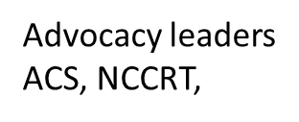
Marketing essentials
Triad
Targets
Message
Patients
Timing
Frequency
Insurers
Health Systems
Providers: Primary , GYN, GI, ONC,
One “perfect” message @ time VS Multiple good/great messages with lead time

Slide 10
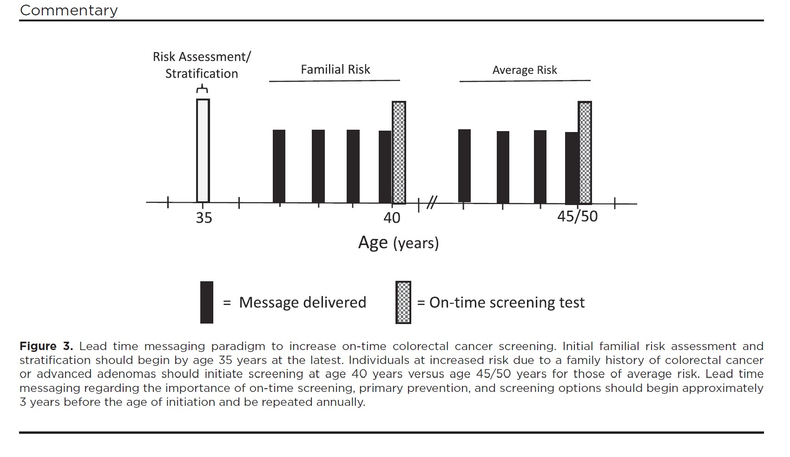

Slide 11
Timeline of EAO-CRC and average risk CRC Messaging Complementary not competitive
Current Message Package
On Time Message
Package
On time date
+
On time options
Early Message Package
+
ID + evaluate symptoms →
ID + evaluate symptoms →
ID + evaluate symptoms →
Family history + test →
Family history + test →
Family history + test →
Lifestyle modification →
Lifestyle modification →
Lifestyle modification →
45yr →
21yr
35-40yr
45/50-75

Slide 12
Needs implementation….STAT!
High risk messaging to age 35-40
Average risk message to 40-45
Implementation of family history collection as a benchmark
Education to all around the signs and sx of CRC sporadic. Reduce delays
Making appointment in advance for your screenings
Data mining → Pt scheduling
Covid-19 plan to increase screenings

Slide 13
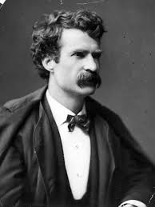
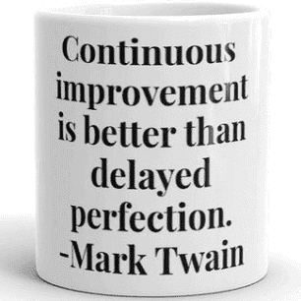
Still Lots left to do.
Logistics
Informatics
Marketing
On-time screening: Gen X Y Z
Providers, consumers
Granular behavior 35-45/H/L risk
Health disparities
Continuous process improvements
Modeling: flatten the curve
Benchmarking 40/45
Health disparities
Etiology EAO

Slide 14
Surveillance
For normal risk individuals
For normal risk individuals
On-time screening
ON-TIME SCREENING FOR HIGH RISK Family Hx CRC, Advanced adenoma, GENETICS
Lifestyle/primary prevention
EAO CRC Awareness

Slide 15
Big Hairy Audacious PLAN (BHAP) Today, NOW, we have data, guidelines, screening tools, great messages 80% on time for every risk group 80% in every community
Reset target demographic messages as a national plan
Morph ACS, NCCRT, Fight CRC, partners to lead time message
Start messaging at least 5 yrs before Family Hx screen needed (40)
Achieve message frequency required (deliverable)
Hard stops @ age 35, 40 and 45. USPSTF now on board (milestone)
Potential to impact 75% EAO CRC NOW, with what we already have
Fund clinical research for on-time screen impact
Elevate Cancer FHx in EHR space (CRC, AA, + other relevant)
Advocate to venders to do so. Position statement with FU report cards –
Collaborate with primary care, payers, GI/GYN/Onc + EHR vendors
Benchmark ala colonoscopy quality improvement process

Slide 16
End of presentation
Remaining slides for information only.

Slide 17
Opposing trends within ages 50-59 years

Slide 18
Tsai M, Xirasagar S, Li Y, de Groen PC. Colonoscopy Screening Among US Adults Aged 40 or Older With a Family History of Colorectal Cancer. Prev Chronic Dis 2015;12:140533.
FDR CRC low rates of on/near time screening
2010 – screening rates 40-49 38% vs >50 69.7%
Only 39% asked by PCP about Fhx CRC ( much less AA)
46% with CRC in FDR thought screening = 50 yo
Conclusions
Pt lack awareness (?providers lack awareness too?)
Pt lack MD recommendations

Slide 19
Clues in our own writings…….. HRSA DOC. We are messaging too late! https://www.hrsa.gov/enews/past-issues/2019/march-7/colorectal-cancer-screenings
- “ ..the group seeks to achieve 80 percent screening in patients over age 50 nationwide.
(STILL FOCUSED ON 50, NOT A WORD ABOUT THE 20-25% NEEDING SCREEN @ AGE 40 OR SOONER)
But the goal so far has only been reached among Americans age 65 and older.
(IS THE MESSAGE DIFFERENT FOR > 65’s, 70’s? , DO WE NOT HAVE GREAT MESSAGE YET?. DID THEY JUST HEAR IT MORE TIMES TO REACH THAT COMPLIANCE LEVEL?) And those gains have effectively been muted by poor adherence among those in their fifties. (WE ARE REALLY MOST POOR AT LANDING THE PLANE ON TIME WITH THE HIGHEST RISK [SCREEN AT AGE 40] EVEN MORE SO THAN AGE 50/45 AND WE BLAME IT ON THE BEHAVIOR OF THE TARGETS, NOT OURSELVES….WOW.)
Deaths from colorectal cancer among people younger than age 55 increased one percent per year from 2007 and 2016.
(NOW 1 IN 5 CASES AND GROWING. WILL WE REVIEW OR ACT ON DATA? WE KNOW ENOUGH, HAVE GREAT GUIDLEINES, ENOUGH TOOLS …READY NOW.) Screening prevalence in that cohort, in particular "is quite low," said Stacey Fedewa of the American Cancer Society – even though more than eight out of 10 of those patients are estimated to have some sort of health insurance. (80% UNSCREENED HAVE INSUREANCE @ NO COST TO SCREEN. HALF OR MORE NEVER HEAR THE MESSAGE AT 50. MEN >> WOMEN.)
- Mew Rattanawatkul of HRSA's Bureau of Primary Health Care noted that HRSA health centers certified as patient-centered medical homes are bucking the trend, but the national average for colorectal cancer screening among the population as a whole was still only about 42 percent.” MAYBE HARD TO REACH POPULATIONS WITH HEALTH EQUITY ISSUES NEED EVEN MORE AND EARLIER + MORE FREQUENT MESSAGING TO HELP OVERCOME THEIR BARRIERS?

Slide 20
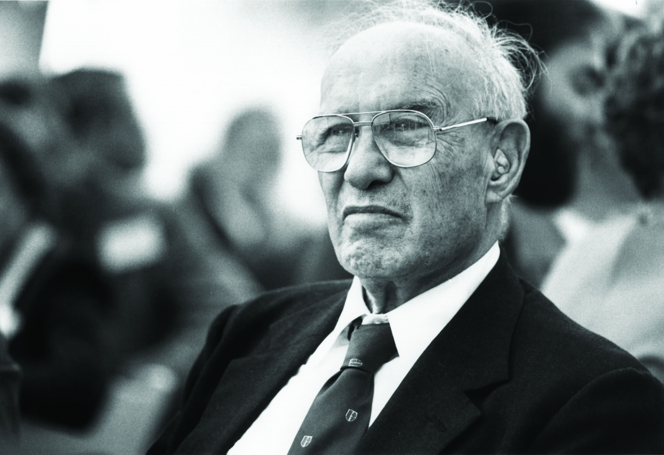
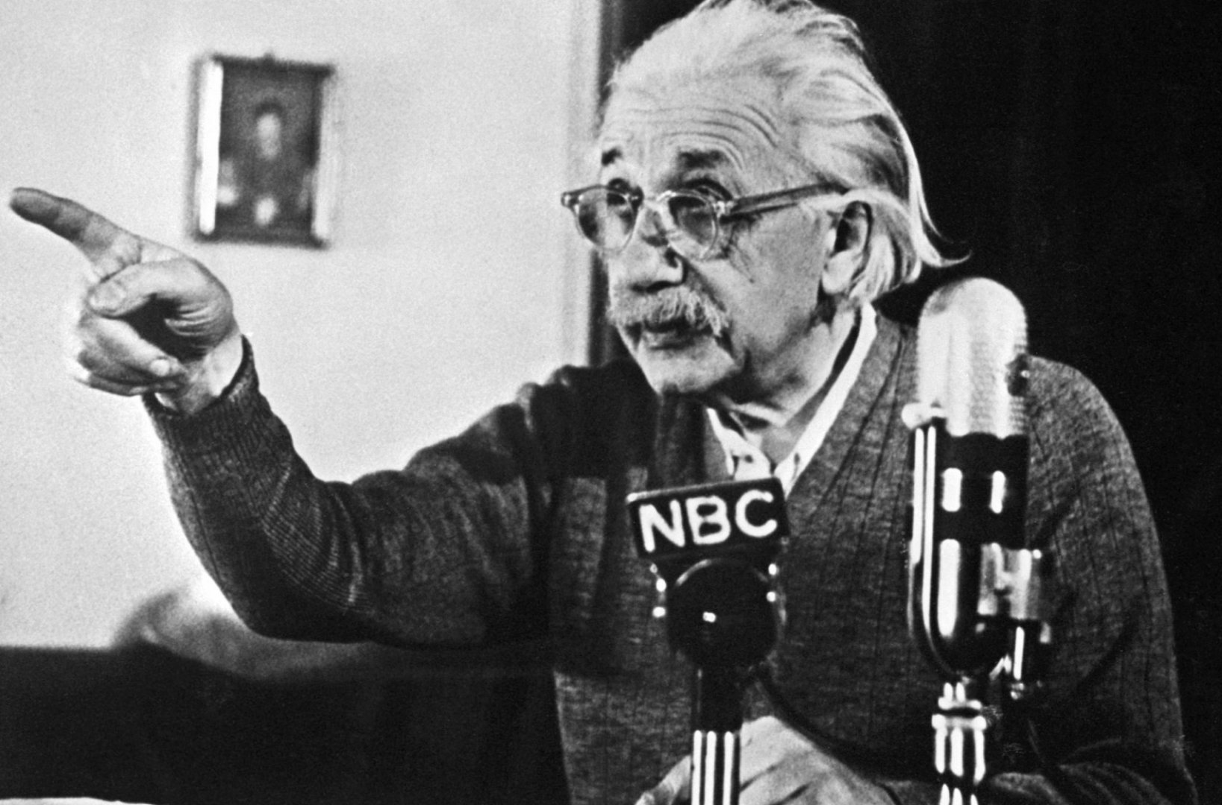
“What gets measured gets managed”
- Drucker
“Not everything that can be counted counts, and not everything that counts can be counted.”
- Einstein

Slide 21
Where and what: Let’s be crystal clear! Study must not preempt action.
Needs Study
Needs implementation
Logistics based screening delivery
Marketing on-time screening: Gen X Y Z
More granular information on behavior around age 40 for high risk and age 45 for average risk.
Benchmarking 40/45
Delivering on data mining> Informatics
Modeling: flatten the curve
How and via which route do we communicate about CRC to 35-45 yo?
Study ongoing implementation efforts for continuous improvement. “ Mark Twain”
Etiology of EAO
Lead time messaging effects on health disparities
High risk messaging to age 35-40
Average risk message to 40-45
Implementation of family history collection as a benchmark
Education to all around the signs and sx of CRC sporadic. Reduce delays
Making appointment in advance for your screenings
Data mining → Pt scheduling
Covid 19 plan to maintain screenings

Slide 22
What we DO have to do.
Pivot to an on-time vs sometime screen paradigm
Expand thinking into the logistics of how to achieve on-time
Lead time messaging enough? Doubtful
Develop/”mine” data: insurers, health systems, Medicaid
Embrace new screening options
Go all in on 45!!!
Re prioritize high risk at 40
Quit blaming our targets
Benchmark Cancer Family History
Professional, Ethical, Moral, obligation

Slide 23
The faces of colorectal cancer are changing….. …………we must adapt our approach! A complementary, not competitive, messaging strategy
Lead time messaging
On-time screening
Whitney F Jones, MD
coloncancerpreventionproject.org
Upstream Health Strategies, LLC
EAO-FHx NCCRT taskforce
October 27, 2020

