Slide 10
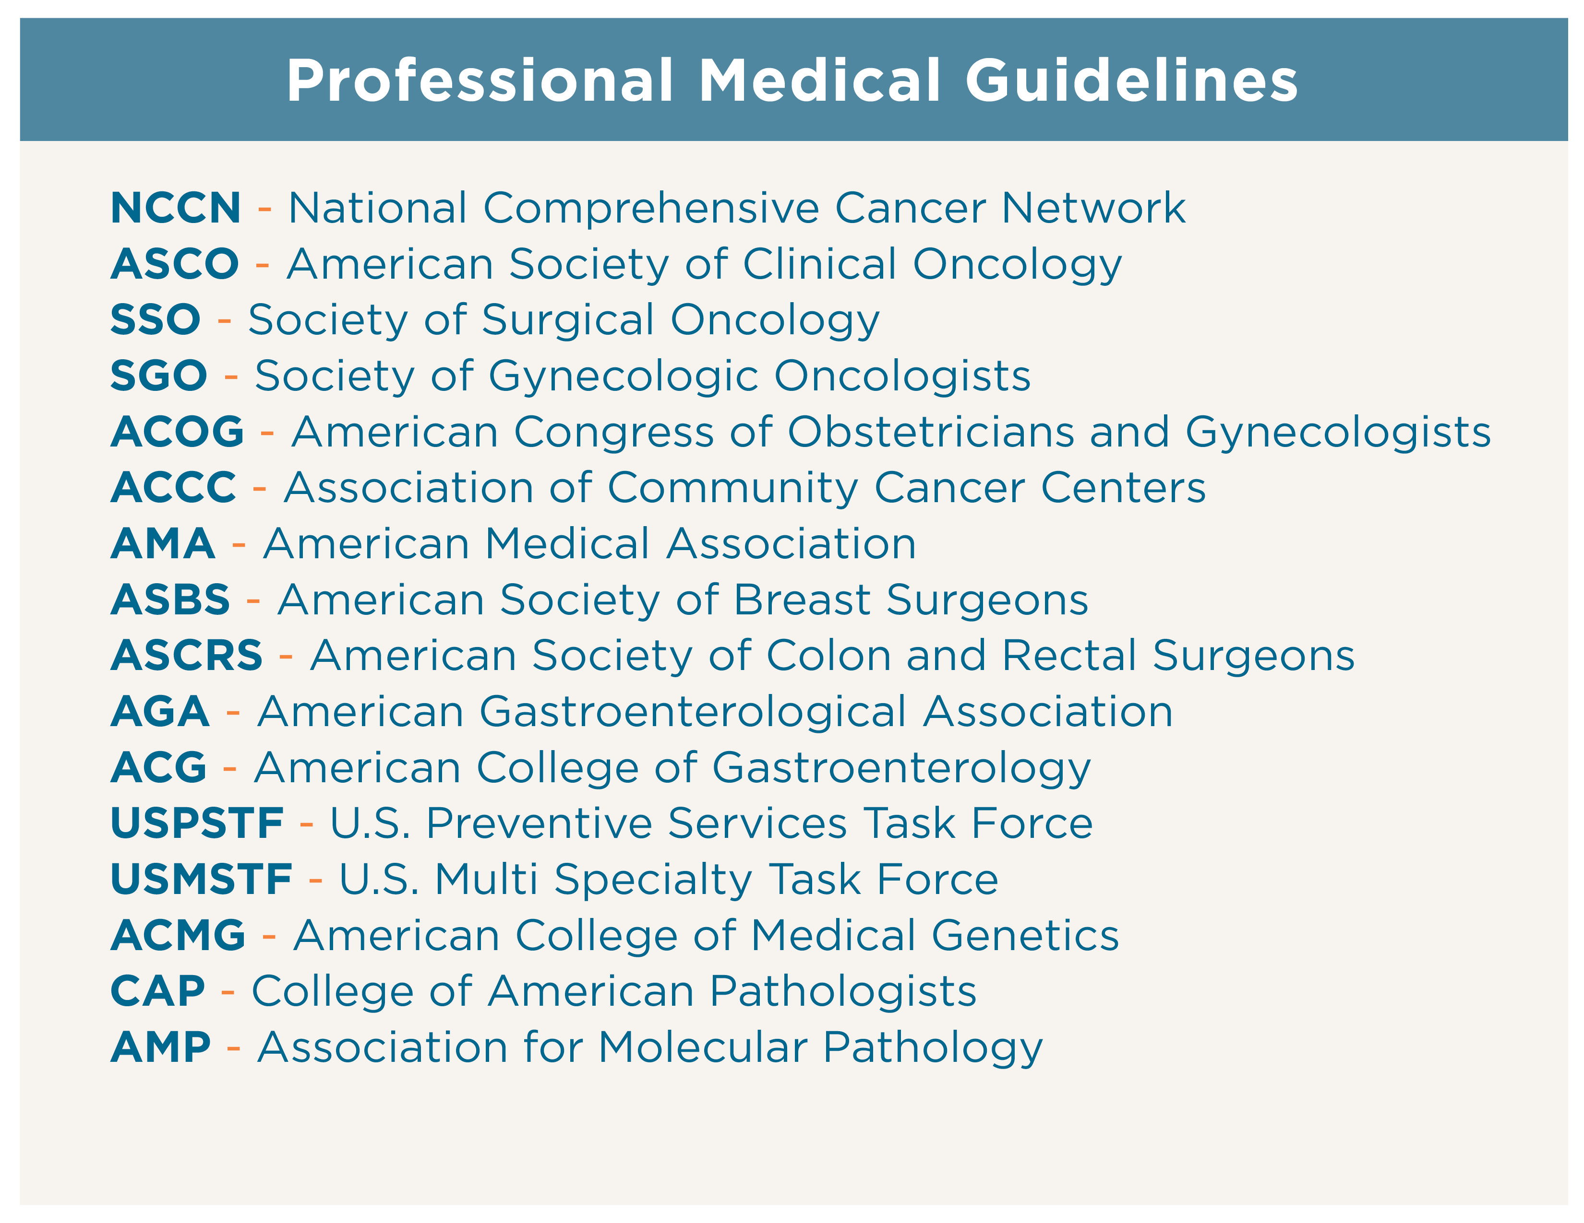

Slide 17
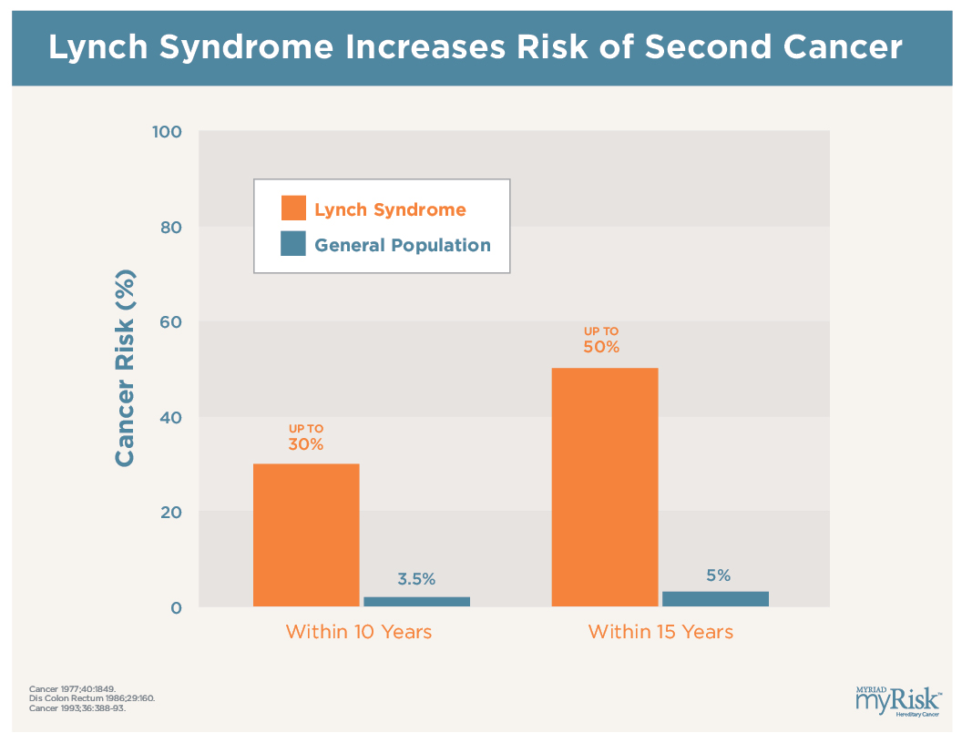

Slide 28
56-year-old female patient
Seen in GI clinic by Gastroenterologist
No personal history of cancer or polyposis
Maternal grandmother breast cancer > age 50; 3 maternal aunts breast cancer > age 50

Slide 29
Notes:
Patient is now known to be at elevated risk for pancreatic cancer. For breast management, when you refer within your Circle of Care, she will be offered the option of increased surveillance +/- chemoprevention OR risk reducing bilateral mastectomies.

Slide 30
31-year-old female patient
Seen in endoscopy suite for personal history of ulcerative colitis
No personal history of cancer or polyposis
Paternal grandmother colorectal cancer @ age 40; aunt breast cancer @ age 55

Slide 31
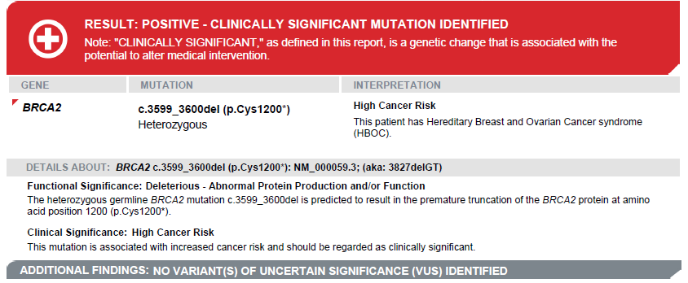
Notes:
Without a panel, this patient would not have qualified for breast gene testing and we would have missed the opportunity to manage her according to her gene-associated risks. Breast cancer risk up to 84%, ovarian risk up to 27%, pancreatic risk 7%, elevated risk for melanoma.

Slide 32
53-year-old female patient
Seen in GI clinic by Nurse Practitioner
Personal history of colorectal cancer and polyposis @ age 27
Mother colorectal cancer @ age 30; son colorectal cancer @ age 21; sister colorectal cancer @ age 29; maternal aunt colorectal cancer; maternal cousin colorectal cancer

Slide 33
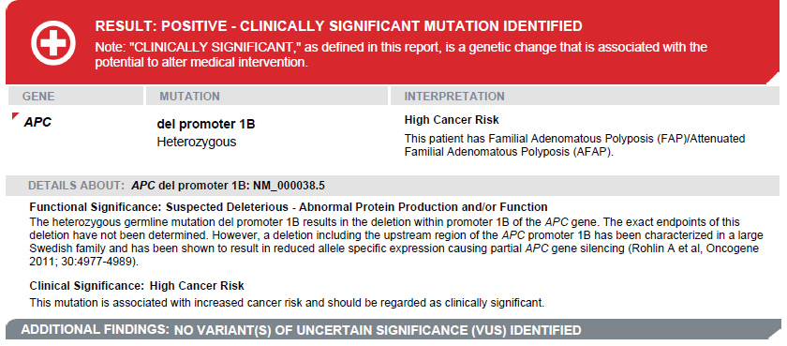
Notes:
She has a clinical dx of FAP/AFAP but it is 26 years after her cancer dx and she’s never had molecular testing. Now every person, including children, in her family can have a clear answer about whether they have the syndrome and very high cancer risks or if they DO NOT and are at AVERAGE risk for colon cancer.

